Slide 1
4N TECH WEBSITE
Introduction
Prepared by:- NATIIII(4)

Slide 2
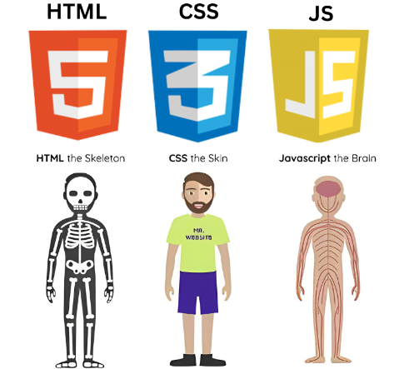
HTML/CSS/JAVA
HTML is Skeleton.
CSS is The Skin.
Java is the Brain or Functionality.

Slide 3
4N TECH Website Tags and Naming
We almost use every TAGS Like :-
<li> <ul> <div> <section> <button> <style>
<nav> <span> <p> <img> <video>
<header> < a > <Big>
<hr> <br> <html> <body> <head> <title>
Special Naming
Id (in style represent by # id name {style})
class (on style represent by . Class name{style})

Slide 4
The `<hr>` tag in HTML is used to create a horizontal rule, also known as a horizontal line or divider, to visually separate content within a webpage
< hr >
The `<br>` tag in HTML is used to insert a line break within a block of text or content. It stands for "line break.“ Here's an example of how the `<br>`tag is used:
<p class=“paragraph 1”> …………… <br> ………………………………………….<br> </p>
<Nav> is used to navigation links
<li> is used to crate list item
<Div> is a tag to Defines a section in a document
Example : <div>
<button><a href=“#.html” ></a> <button>
</div>

Slide 5
<span> - Defines a section in a document
< section > - Defines a section in a document
< video > - Defines a video or movie
< img > - Defines an image.
We use this tags on 4N TECH Website
let me show u styling system on our website
Font-size
Display
Background image
Text-align or align
Padding include : left , right , top , bottom
Margin include : left , right , top , bottom
Width / height /border
Position
Transition

Slide 6
The <style> tag in HTML is used to define the styling rules for elements within a web page. When it comes to setting the background of an HTML element
In our home page we. used background image, background-repeat, background-attachment, background-size.
Background Image (background-image) This property is used to set one or more background images for an HTML element. You can specify a URL to an image file, and the browser will display that image as the background of the element.
Background Size (background-size):This property controls the size of the background image.

Slide 7
On this style page we use two main part
ID is represent by #
For example : #testimonials{
display:-webkit-inline-box;
}
Class is represent by .
For example : . main-nav{
font-size: 1.1em;
font-width: lighter;
border-bottom: 1px solid rgba(255, 255, 255, .3);
}
Button - Defines a clickable button
For example - <button> CPU </button> gives:
cpu

Slide 8
< body > tag is the main part of the website
we can edit everything under the body file like there back ground , colour , font , align everything.
for example : <body background =“ img /…”> or colour
<body align=“ center”>or right or left
<body font-size =“20px”>or font-family
<style> style is the editing place of the web page
For example :
<style>
.main-header{
Color: black;
Font-size: 20px;
}
</style>

Slide 9
<img src=“img/#.jpg or png” Width=“200” align=“center”>
<video controls Auto play loop src=“video/.mp4” width=“500”></video>
<h1 style=“background: yellow ; ”> cpu </h1>
<p class=“pargraph-1”> my name is natnael am web designer </p>
< div>
< button><a href=“contact Us ”> Contact US </a><button>
</div>
<!----The End---->

